Slide 1

WELCOME
SYLVAN HILLS MIDDLE
GO TEAM MEETING

Slide 2

Let’s commit to:
Wearing masks and socially distancing
Being present and engaging meaningfully so that we can learn from each other (i.e. Cameras on)
Refrain from using electronic devices unless required to engage in the work
Muting your microphone (VIRTUAL) and minimizing extraneous conversations
Assuming good will
Allowing all voices of the team to be heard
Focusing on the day’s content
Starting and ending on time
Being gracious

Slide 3

Today’s Agenda
Call to Order
Roll Call; establish quorum
Action Items
  Approval of Agenda
  Approval of Previous Meeting Minutes
  Fill GO Team Position- Swing Seat
  FY22 Budget Development Presentation
Information Items
  Principal’s Report
Announcements
Public Comment
Q & A
Adjournment

Slide 4
GO TEAM MEMBERS 20-21
NAME | ROLE
Ms. Monica Blasingame | Principal
Ms. Jessica Bracey | Parent
Ms. Queen Rosa Harden-Green | Parent
Mr. Mark Gresham | Parent
Ms. Sade Miller | Staff
Mr. Derwin Purnell | Staff
Ms. Sonjyia Bryant | Staff
Ms. Keisha Mackey | Community Member
LaSandra Brown | Community Member
Ms. Johna Rhooms | Swing Seat

Slide 5

Action Items
.
Action Items
  Approval of Agenda
  Approval of Previous Minutes
  Fill Vacant GO Team Position- Swing Seat

Slide 6

SHMS Priorities 2020-2021
Cultivate a literate community in which students read and write with clarity and fluency across all contents
Foster ongoing support for teacher development

Slide 7




Sylvan Hills Middle (Carver Cluster)
District Mission & Vision
Cluster Mission & Vision
School Mission & Vision
With a caring culture of trust and collaboration, every student will graduate ready for
college and career.
A high-performing school district where students love to learn, educators inspire, families engage and the community trusts the system
Through a culture of collaboration, respect, and trust, the Carver Cluster will enhance and strengthen its overall academic programs while maintaining a sage and nurturing environment that prepares students for college and careers.
The Carver Cluster will produce high-performing, college and career ready students that are globally aware and ready to have a positive impact on society.
It is our mission to provide a learning environment that ensures high expectations for all of our scholars through quality instruction, real-world applications and technology that promotes and fosters knowledge and skills.
Sylvan Hills Middle School will provide a nurturing and safe environment where scholars become critical thinkers, problem solvers, lifelong learners, and productive citizens.
Signature Program: College And Career Prep
School Priorities
School Strategies
Key Performance
Measures
Cultivate a literate community in which students read and write with clarity and fluency across all contents
Improve students’ mathematics performance
Improve students’ enrollment and success in higher-level classes
1A. Develop, implement and monitor best writing practices across all contents. 1B.Implement a meaningful literacy/math block (SFA) that includes whole group instruction, flexible small group instruction and literacy work stations.
1C. Develop and implement a Response to Intervention (RTI) plan, beginning with strong first teaching and targeted intervention.
1D. Implement Definitions of Teaching Excellence
2A-E. Same as 1B-1F
2F. Implement weekly common assessments
2G. Focus on unit assessment performance
3A. Develop master schedule aligned with student data, needs, and high school course offerings
3B. Offer more courses that will earn high school credits
Increase students performance on GA Milestones in Reading, Writing, and Math.
Increase student performance on STAR Assessment.
Increase students performance on 4sight reading assessment (quarterly).
Improve performance on district benchmark assessment
Improve NAEP scores (8th grade only)
Increase the number of parents and community members that participate in local and state administered surveys.
Increase TKES evaluation scores
Increase overall CCRPI rating
Improve students’ attendance
Improve culture and climate ratings
Academic
Program
Foster a culture of ongoing support for teacher development.
Recruit and maintain highly talented faculty/staff trained in researched-based best for developing the total middle school student (academically, socially, and emotionally)
4A. Identify teacher growth opportunities to provide ongoing coaching support.
Communicate clear expectations and feedback to teachers.
4B. Consistently implement revised teacher induction program for staff new to Sylvan.
4C. Provide ongoing valuable staff development designed to help staff elevate the rigor in the classroom and help students utilize higher order thinking, reading and writing skills.
5A. Establish and maintain incentive program to reward faculty and staff who consistently demonstrate the highest standards of professionalism.
Talent
Management
Engage all facets of the community as partners and align people and resource to maximize impact.
6A. Build relationships between school leadership/staff and partner leadership in order to better serve the needs of the Sylvan Hills community.
6B. Strengthen family and community support to increase parent involvement.
6C. Establish and maintain communication with the community about formal and diverse engagement opportunities at Sylvan Hills.
6D. Offer ongoing surveys to students, staff, and parents to determine needs and current awareness of existing programs and community resources.
Systems &
Resources
Provide increased teaching and learning opportunities for all staff and students.
7A. Implement Social Emotional Learning (SEL) daily.
7B. Utilize the services of the Northstar Psychological Services and other providers to assist students/families.
7C. Create a culture to support and encourage our students to behave in a positive manner where they all can learn and feel protected in a safe and orderly environment
Culture

Slide 8

SY22 Budget….

Slide 9

SHMS SY22 BUDGET.…
What does that mean?
Projected Enrollment | 513 students
Allocation | $6,204,756
Change in Enrollment | -12
Signature Program | $160,500
Turnaround | $0
Title I | $322,920
Family Engagement | $11,000
Title School Improvement | $0
Total FTE Allotments | $1,663,800
Unallocated Funds | $155,645

Slide 10
Budget by Function – Non-staffing
Notes:
I am passing out the definitions for these funding categories. You will see what makes up each category. Although the total amount will not change, allocation per function may depending on our conversations and school needs.

Slide 11
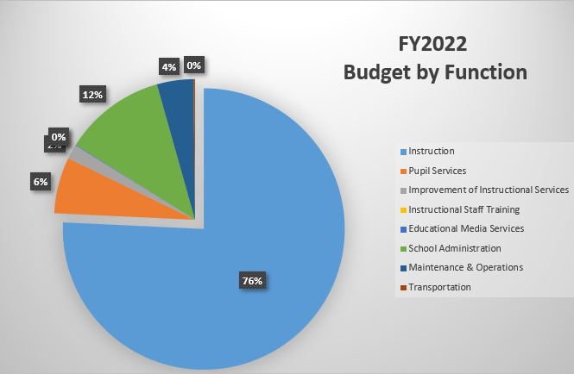
Budget by Function – Non-staffing

Slide 12
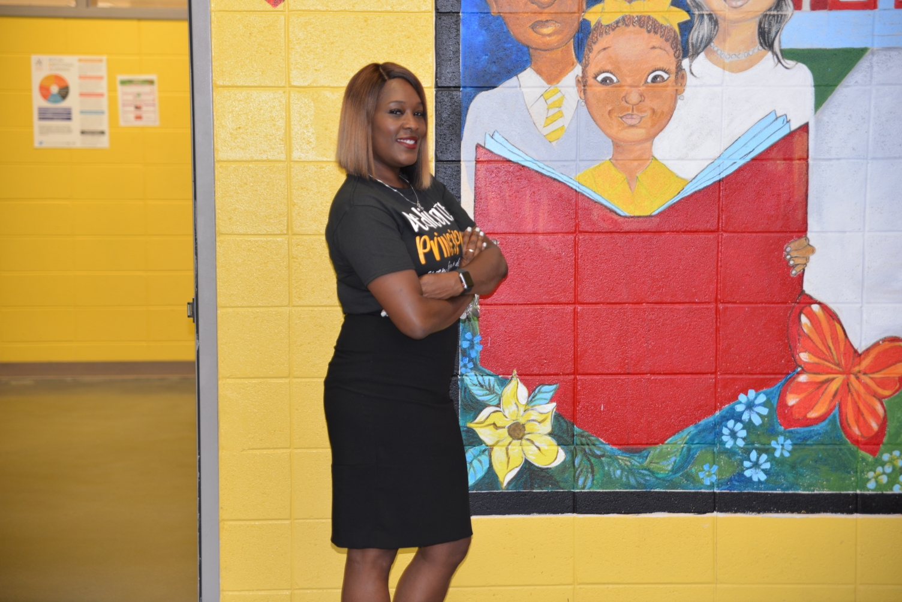
PRINCIPAL’S REPORT
Return to Learn: Phase 2 Updates
This week we celebrate…
National School Counselors Week

Slide 13

Traditional Bell Schedule

Slide 14

4th Quarter Intent-to-Return
Families must declare their student’s Intent-to-Return to APS schools beginning February 17th and before March 1st for the 4th Quarter.

Slide 15

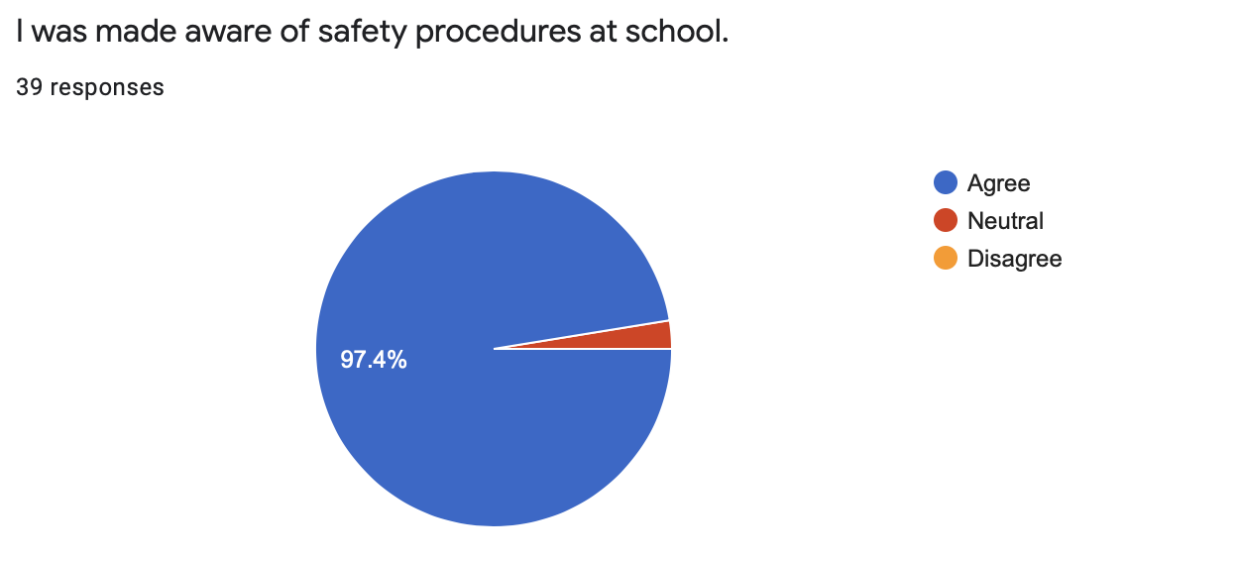
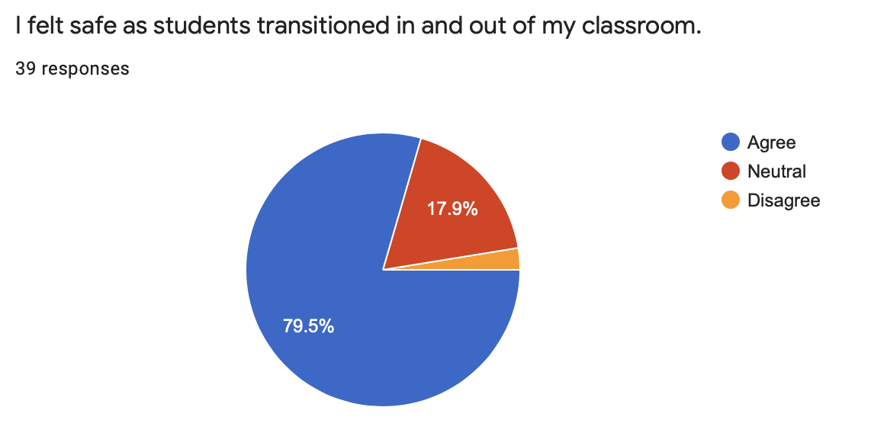
Day One
(Teachers’ Viewpoint)

Slide 16

Teachers
What did you like most?
What changes need to be made?
Seeing the students
Phase II documents and procedures were helpful
Calm atmosphere
Supportive
Transitions
Hand sanitizer at the door
Faster Dismissal

Slide 17
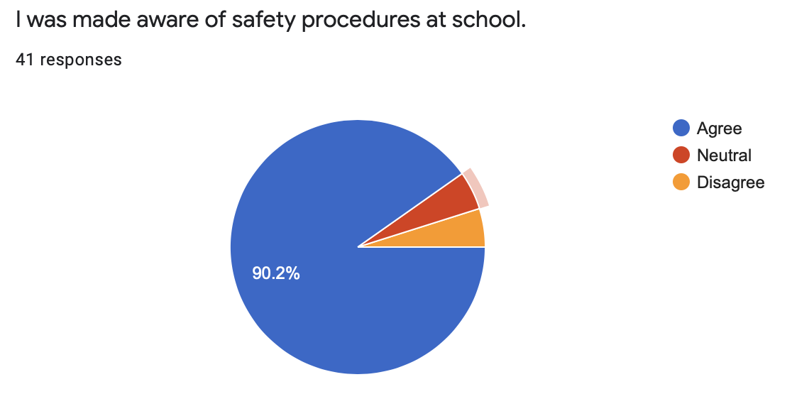
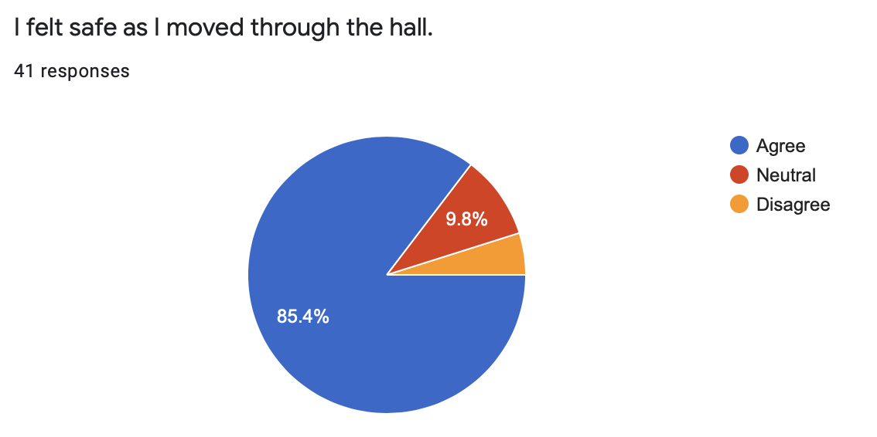
Day One
(Students’ Viewpoint)

Slide 18
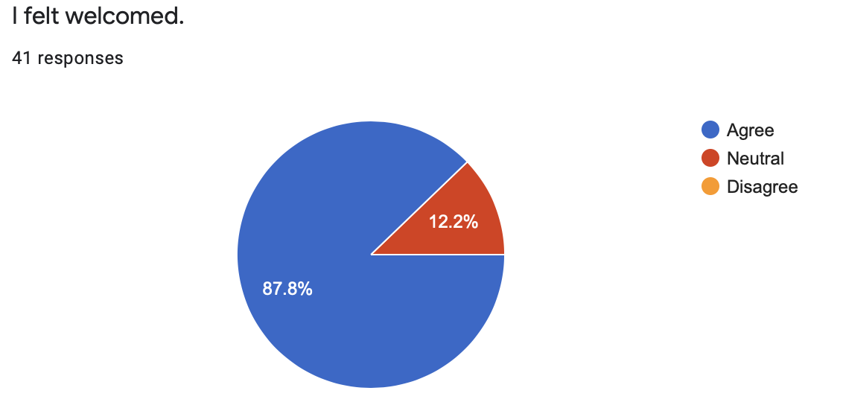
Day One
(Students’ Viewpoint)

Slide 19
Students
What did you like most?
What changes need to be made?
Seeing kids.
Felt good to be back in school.
Met my teachers
The breaks and lunch
Peace
One-directional paths
Wearing masks
Restroom breaks take too long

Slide 20
Public Comment Format
Sylvan Hills Middle School's GO Team welcomes input from students, staff, parents and community members during designated meetings. This includes an opportunity for public comment at the end of the meeting not to exceed 20 minutes. To register for an opportunity to speak, please adhere to the following:
1. Register at the sign-up table (google form will be available for virtual meetings) no later than 30 minutes prior to the Go Team meeting dates.
2. Please include your name, email address, and topic.
3. Community members signing up to speak will be given two (2) minutes.
4. The Go Team cannot take public comment on personnel issues.

Slide 21

Announcements
Public Comment
Adjournment

